Slide 1


Apple M1 CPU

Slide 2

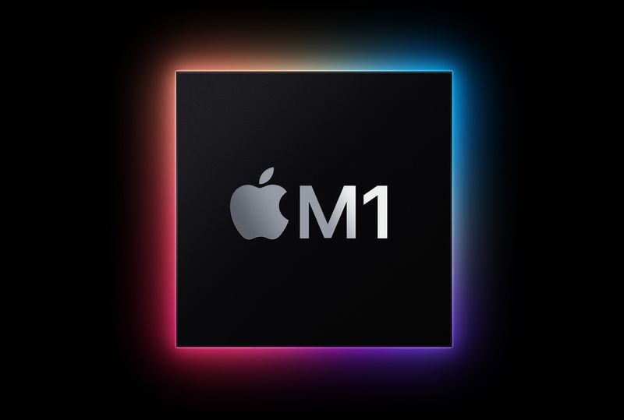
Apple M1 Chip
Apple in November 2020 released the first Macs with an Arm-based M1 chip, debuting 2020 13-inch MacBook Pro, MacBook Air, and Mac mini models. In early 2021, Apple added the M1 iMac and the M1 iPad Pro. The M1 chip received rave reviews for its incredible performance and efficiency, and it is the culmination of more than a decade of Apple's work on chips created for the iPhone and the iPad.
This guide walks through everything that
you need to know about the M1 chip and
how it's different from the Intel chips that came before it.

Slide 3

01
Apple's M1 Chip Explained
03
Macs With M1 Chip
02
What's Different About the M1

Slide 4

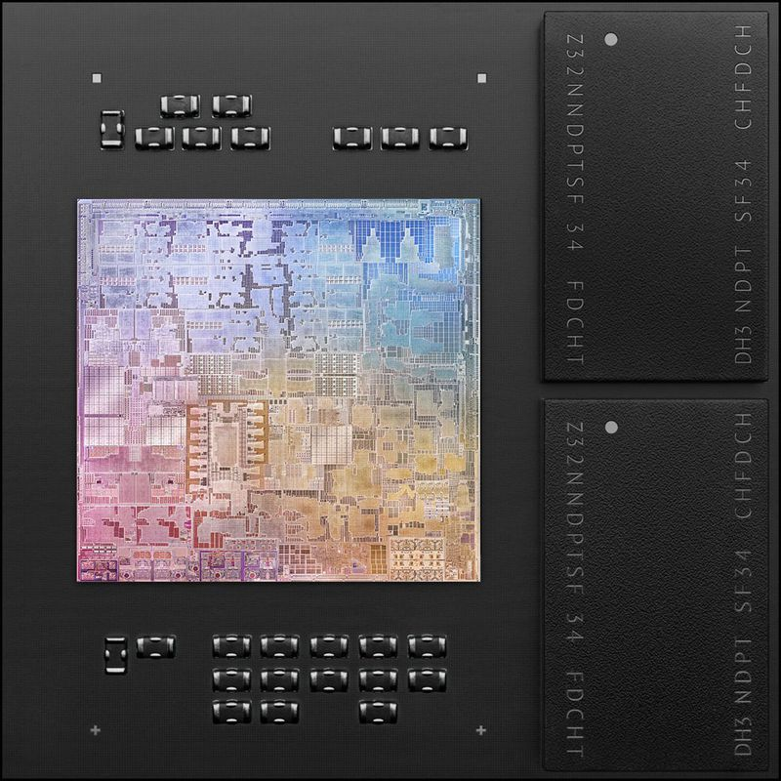
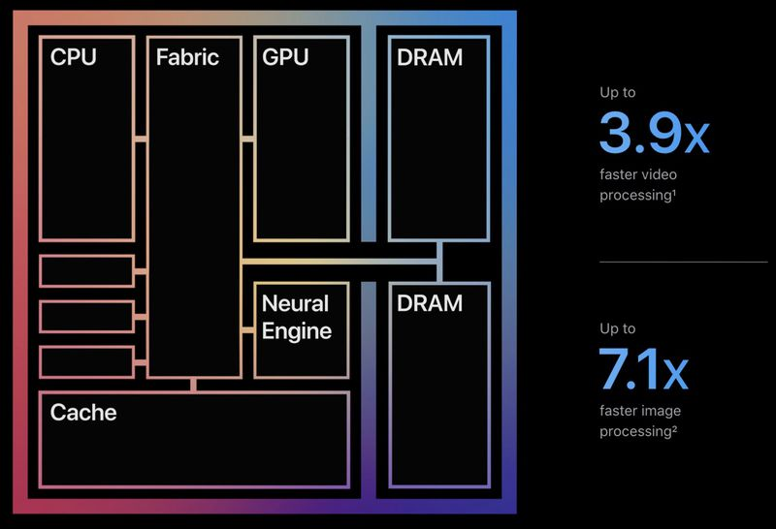
Apple's M1 Chip Explained
The M1 was the first Apple-designed System on a Chip (SoC) that's been developed for use in Macs. It marked Apple's first step toward transitioning away from the Intel chips that the Cupertino company used in Macs since 2006.
As a "System on a Chip," the M1 integrates several different components, including the CPU, GPU, unified memory architecture (RAM), Neural Engine, Secure Enclave, SSD controller, image signal processor, encode/decode engines, Thunderbolt controller with USB 4 support, and more, all of which power the different features in the Mac.
Before Apple silicon, Macs used multiple chips for CPU, I/O, and security, but Apple's effort to integrate these chips is the reason why the M1 is so much faster and more efficient than prior Intel chips. The unified memory architecture that Apple has included is also a major factor because all of the technologies in the M1 are able to access the same data without having to swap between multiple pools of memory.

Slide 5
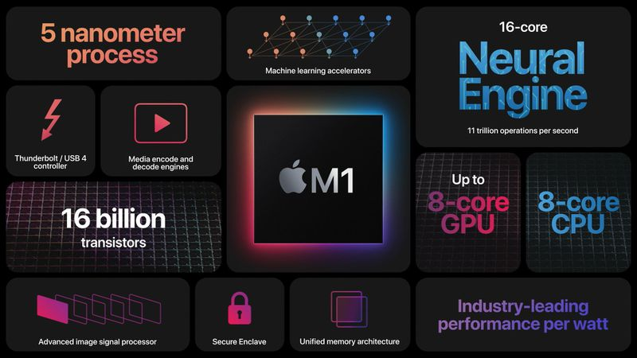
What's Different About the M1
Unlike Intel chips built on the x86 architecture, the Apple Silicon M1 uses an Arm-based architecture much like the A-series chips that Apple has been designing for iPhones and iPads for years now.
The M1 chip is the most powerful chip that Apple has created to date, and it is similar to the A14 chip in the latest ‌iPhone‌ and iPad Air models, built on a 5-nanometer process by Taiwan Semiconductor Manufacturing Company (TSMC). TSMC builds all of Apple's chips and has done so for many years.

Slide 6
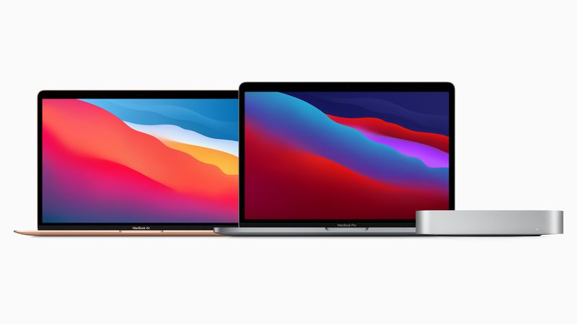
Macs With M1 Chip
Apple has released the 2020 ‌MacBook Air‌, 13-inch MacBook Pro, and ‌Mac mini‌ with M1 chips, replacing the low-end machines in those lineups.
Apple has also introduced M1 versions of the ‌iMac‌ and the ‌iPad Pro‌.

Slide 7
CPU, GPU, and Neural Engine
01
CPU

Slide 8
WHAT a CPU?
The M1 chip includes an 8-core CPU with four high-performance cores and four high-efficiency cores. The high-performance cores are designed to offer the best performance for power-intensive single-threaded tasks.
The four high-performance cores can work together to offer impressive multithreaded performance that has allowed the M1 Macs to outshine even the highest-end 16-inch MacBook Pro models.
For tasks that are less intensive and don't require the same power, such as web browsing, there are four high-efficiency cores that use a tenth of the power to preserve battery life.
Apple says these cores offer performance similar to the prior-generation dual-core ‌MacBook Air‌, but at much lower power. These cores can work alone when significant power isn't needed, but for demanding tasks, all eight cores can be engaged at one time.
Benchmarks of the ‌MacBook Air‌, MacBook Pro, and ‌Mac mini‌ have confirmed the M1 chip's impressive performance. There are some thermal differences between the models, but all have the highest single-core performance out of any Mac and multi-core performance on par with Apple's desktops.

Slide 9
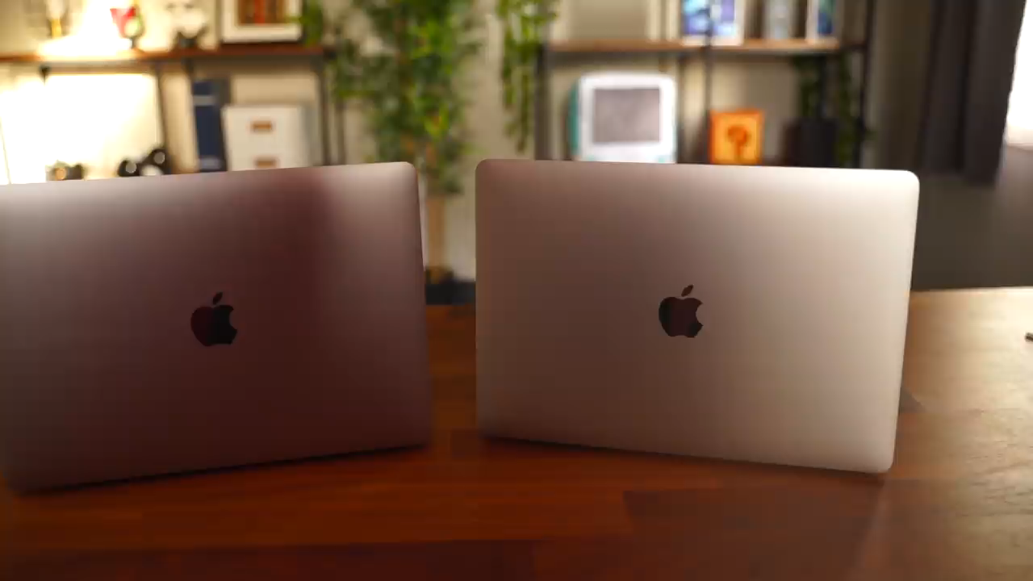

Slide 10
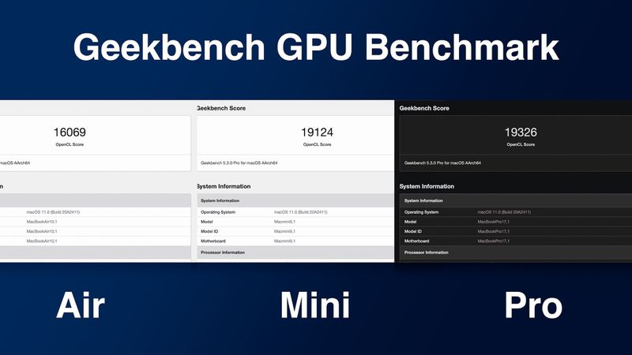
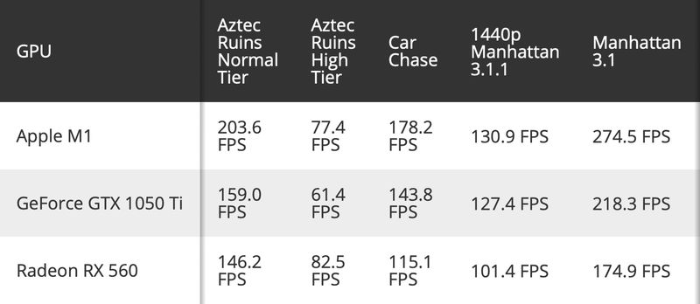
What a GPU
The ‌Apple Silicon‌ chip has an 8-core GPU, but there's also a version used in the entry-level ‌MacBook Air‌ models that has one of the cores disabled for a 7-core GPU.
GPUs in the ‌Mac mini‌, MacBook Pro, and higher-end M1 ‌MacBook Air‌ models are all 8-core GPUs capable of running close to 25,000 threads simultaneously and with 2.6 teraflops of throughput. According to Apple, the M1 has the fastest integrated graphics in a personal computer.
Graphics performance tests have suggested the M1 chip offers performance that exceeds the GeForce GTX 1050 Ti and Radeon RX 560. It also earned an OpenCL score of 19305, similar to the Radeon RX 560X and Radeon Pro WX 4100.

Slide 11
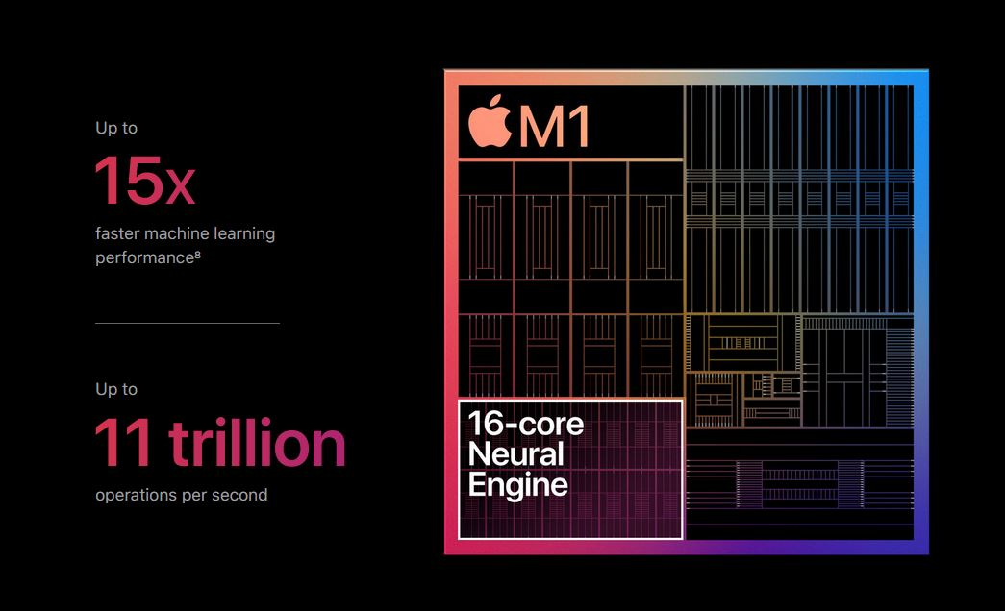
What a Neural Engine
The M1 chip has a built-in Neural Engine, a component that Apple first started adding to its A-series chips a few years ago. The Neural Engine is designed to accelerate machine learning tasks across the Mac for things like video analysis, voice recognition, image processing, and more.
The 16-core Neural Engine is capable of 11 trillion operations per second for up to 15x faster machine learning performance compared to the previous generation of models that have moved to the M1.

Slide 12
Battery Life
Apple M1 Speed
M1 Security Features
Running Apps on M1 Macs

Slide 13
Apple M1 Speed
Battery Life
The M1 chip brings up to 3.5x faster CPU performance, up to 6x faster GPU performance, and up to 15x faster machine learning capabilities compared to the Intel chips used in prior-generation machines.
Compared to the latest PC laptop chips, the M1 offers 2x faster CPU performance and does so using just 25 percent of the power.
Even with the incredible speed improvements that the M1 chip brings, it is also more battery-efficient than any other Mac chip Apple has released to date.
Battery life in an M1 Mac lasts up to 2x longer than in prior-generation Macs. The Mac with the longest battery life is the 13-inch MacBook Pro, which lasts for up to 20 hours. That's double the battery life of the prior-generation model.

Slide 14
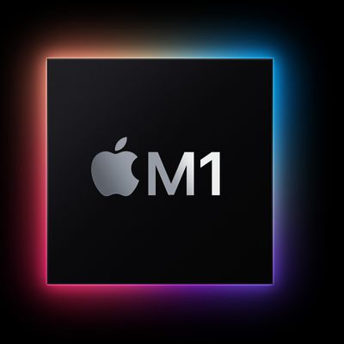
M1 Security Features
Intel Macs had a built-in T2 chip that handled security and other features on the Macs, but with the M1 chips, that functionality is built right in and a secondary chip isn't required.
The M1 has a built-in Secure Enclave that manages Touch ID and a storage controller with AES encryption hardware for SSD performance that's faster and more secure.

Slide 15
Running Apps on M1 Macs
Because the M1 chip is using different architecture, Apple has built tools to allow developers to create Universal app binaries that run flawlessly on both ‌Apple Silicon‌ and Intel chips, plus it has developed the Rosetta 2 translation layer that allows x86 apps to run on the M1 chip.
Rosetta 2 is a reimagining of Rosetta, the feature that allowed PowerPC apps to run on Intel-based Macs back in 2006 when Apple swapped to Intel from PowerPC.
With Rosetta 2, apps designed for Intel machines will continue to run on M1 Macs with some limited performance compromises. For the most part, apps run similarly on both Intel and M1 Macs due to the performance improvements introduced in the M1.
Everything should function as normal when transitioning to M1 Macs, and over the course of a few years, most popular Mac apps will likely be built to run on the M1 Macs natively. Right now, there is one major compromise when choosing an M1 Mac, and that's Windows support.
There is no Boot Camp for M1 Macs and M1 Macs are not officially able to run Windows, although some users are figuring out ways to make it work. Official support could come in the future, but it largely depends on Microsoft licensing its Arm-based version of Windows to consumers, and so far, that hasn't happened.
M1 Macs can run ‌iPhone‌ and ‌iPad‌ apps as well as Mac apps, so long as app developers make them available on the Mac. There used to be a way to sideload any iOS app on an M1 Mac, but that functionality was removed in January 2021.

